Slide 1

Working Together
Educators & Parents Special Education
Notes:
Investing in our children is our most important investment for the community and for the world

Slide 2
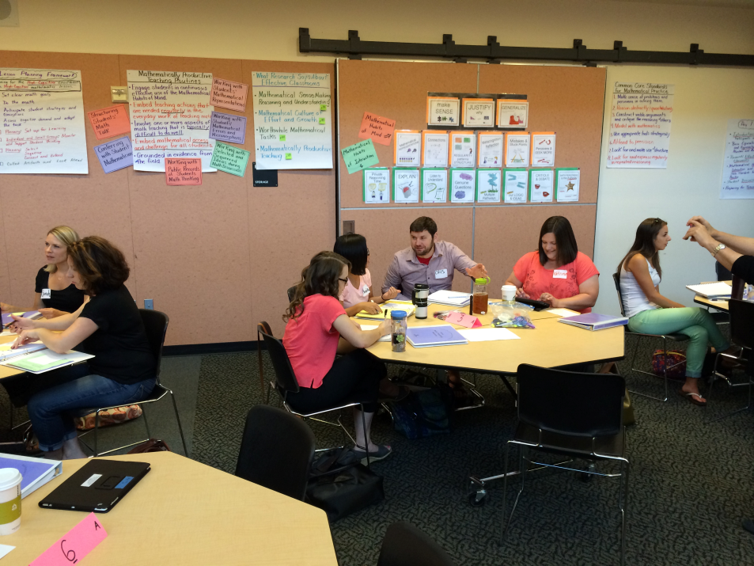
“How do we create learning communities for the greatest thinkers and most thoughtful people… for the world?”
Vision
Learning Communities
Great Thinkers
Thoughtful People
For the World
Notes:
As I observed and participated in some of the most impressive teamwork I have ever been a part of I found myself increasingly intrigued and challenged by our vision question. I was again struck by what an important and compelling question it asks.

Slide 3
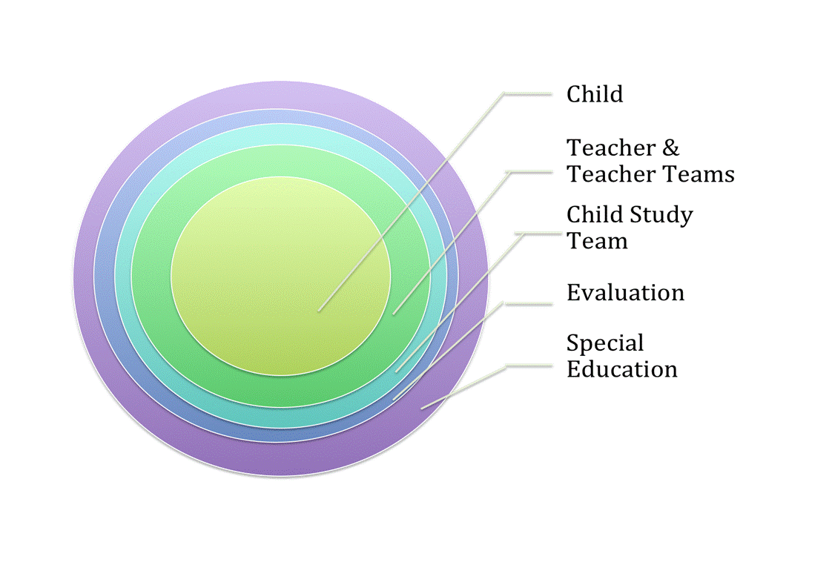
Circles of Support
& Parent

Slide 4
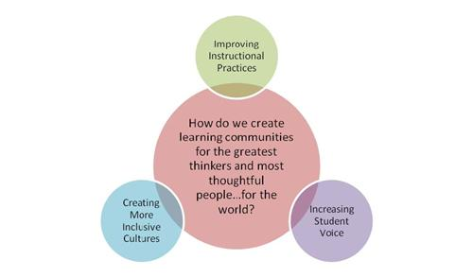
SPED Department Focus
Notes:
We have encouraged looking at the familiar with new eyes.

Slide 5
Brief Overview of SPED Services in WLWV
919 students served
Inclusive focused supports:
  80.6% in general ed setting for >80% of day (state average is 73% in this setting)
Above state averages in key Achievement Compact indicators for SPED
  On-track HS credits: WLWV 75.7% State 61.4%
  4 Year Graduation: WLWV 68.3% State 37.2%

Slide 6
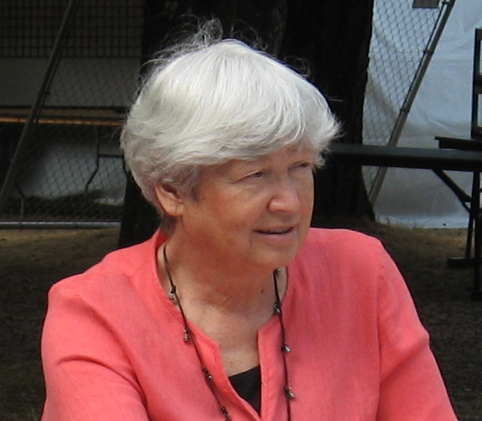
“We can be the school district that delivers on the promise for every child, each child”.
-Jane
Notes:
It has become increasingly clear the connection between our ability to answer that question and the vision of delivering for every child, each child.

Slide 7

Important key… PARENTS!

Slide 8
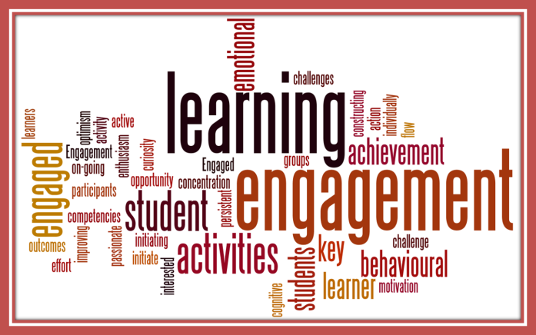
Board Goals
1. Grow student achievement, through the use of high leverage instructional strategies that raise rigor for all students while closing achievement gaps.
2. Align systems of professional growth, assessment, and accountability, to support the West Linn-Wilsonville vision of excellence in teaching and learning.
3. Establish long-term financial stability and sustainability and maintain responsiveness to community growth and student learning needs by engaging in practices and processes leading to a successful result in a capital bond and local option levy election.
4. Engage family and community partners in support of the district vision and values of excellence in education.
5. Implement systems of high quality professional growth and mentoring that establish safe learning environments and recognize the accomplishments of staff as they persist toward the achievement of rigorous learning goals.

Slide 9
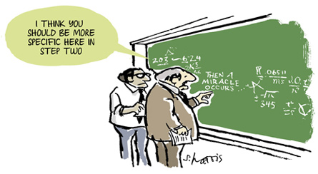
Theory and Practice of
Working Together

Slide 10
Parent Involvement in Effective Circles of Support for SPED
Parent Orientation to Special Education Process
Twice per year outreach to parents of children newly identified or newly moved into district
January orientation around kindergarten transition for parents in ECSE
Parent Resource Events & Communication
Partnership with FACT, Recent Event
District & Parent SPED Collaboration Group
Developing Shared Understanding & Hearing Key Voices
Specific ideas/projects: Website, Conferences, News letter
The IEP Process
The Relationships & Collaboration at Each School
Quarterly newsletter

Slide 11
*The IEP Process
*Relationships & Collaboration at each school
IEP= Individualized Educational Plan
  The Parent’s role is crucial!
  Legal requirements
  Beliefs in what best supports children
15 Schools with Outstanding Leaders & Educators
  Systemic and informal ways to engage with parents

Slide 12
Parent Orientation to SPED Processes
*Parents new to services
*Parents of incoming kinders with ECSE services
Parents New to SPED Services in WLWV
  2 times per year
  Demystifying what may seem complex, jargon, etc
  Sets the stage for positive partnership in the process
  Invitations sent to parents of children:
    Newly identified for services
    Recently moved into district with services
Parents of Children Coming to Kindergarten from ECSE
  January orientation, May transition IEP meetings

Slide 13
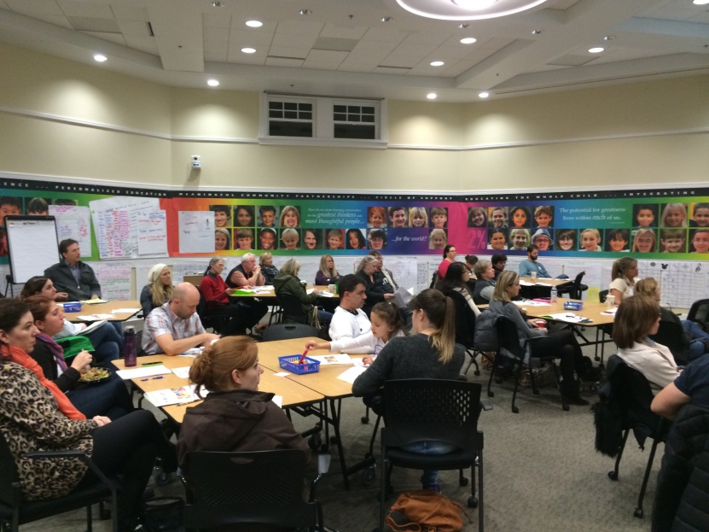
*Resources & Events
*Often Partnering with FACT
Examples of Resource Events Held:
  Understanding the IEP & Parents Crucial Role (facilitated by FACT)
  Transition Fair
    Reps from VR, PSU, CCC, etc
  Diploma Information Night

Slide 14
District & Parent SPED Collaboration Group
  To provide input on how we establish priorities and goals for West Linn-Wilsonville Schools in supporting students with disabilities
  To be key communicators in developing deeper understanding around complex issues in special education
  To support collaboration in the special education process between parents and district educators
  To support the awareness of resources available to parents through the special education process and in positive community inclusion

Slide 15
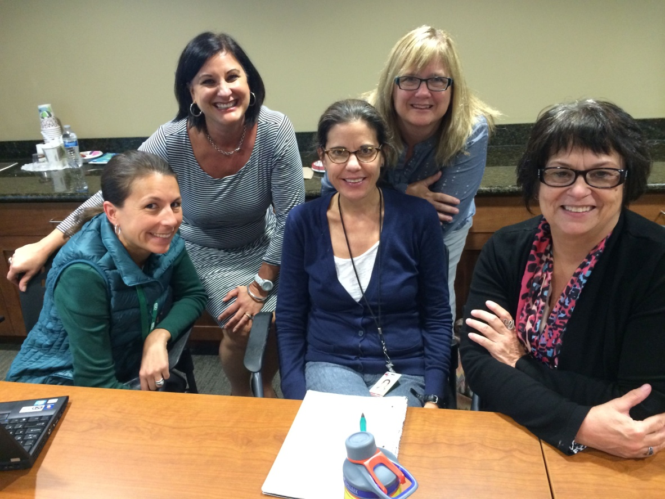
New Ways to Develop Parent Partnerships
Evaluations for Early Intervention & Early Childhood Special Education

Slide 16
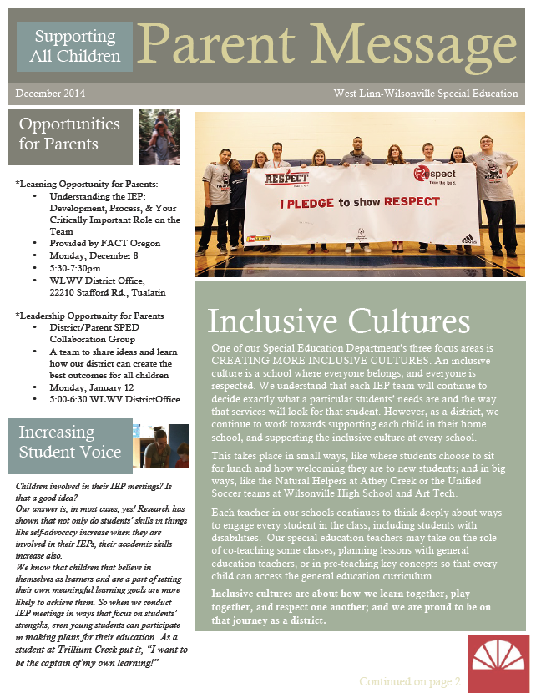
New Ways to Develop Parent Partnerships
Quarterly Parent Message
Bilingual Evaluation & Parent Support Assistant

Slide 17
Working Together
Educators & Parents Special Education
Notes:
Investing in our children is our most important investment for the community and for the world

